Slide 1
Plan of action
SDLC exam
C++ exam – Fri July 5th 2019
Arduino – enrichment

Slide 2
polymorphic
classes

Slide 3
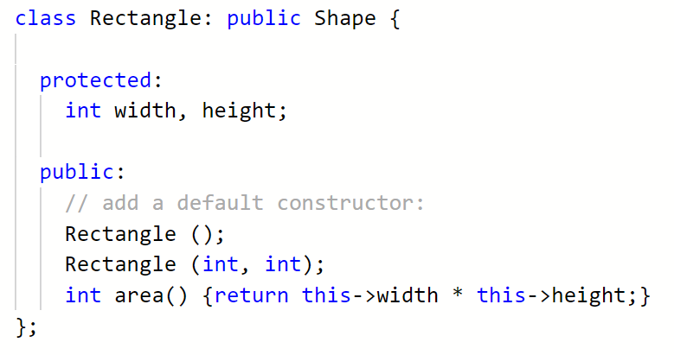
Last week

Slide 4
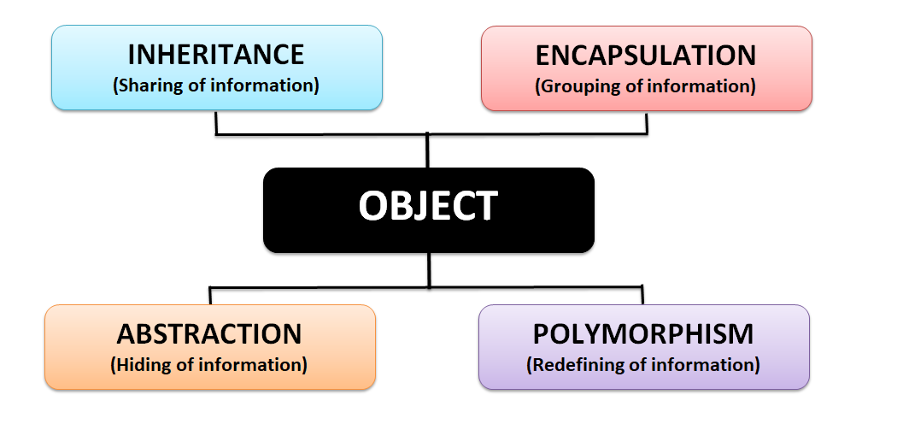
4 pillars of object oriented code

Slide 5
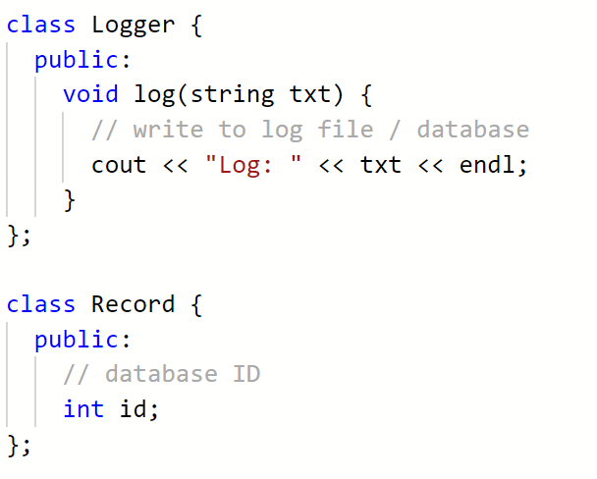
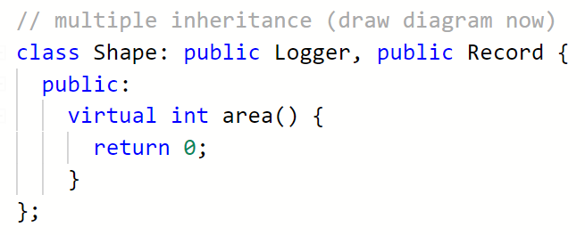
https://repl.it/@JohnGlazebrook/c-classes-3-inheritance-6

Slide 6
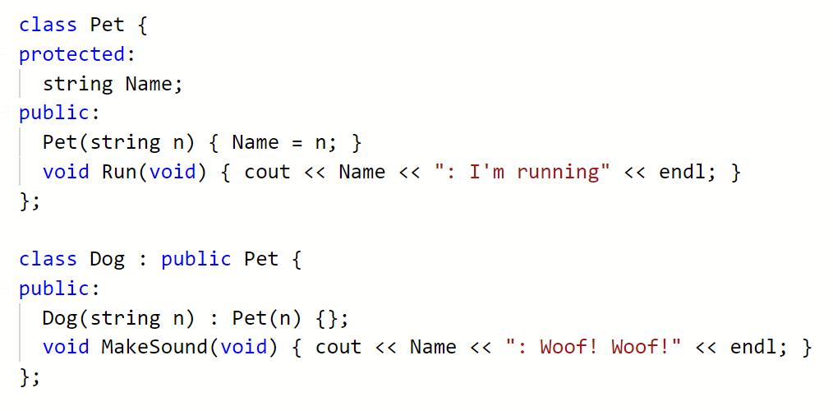
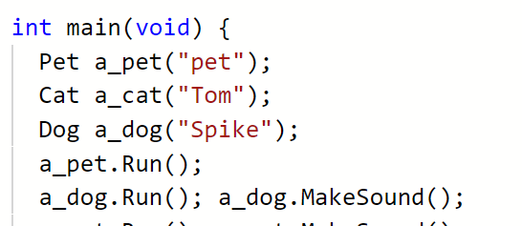

Slide 7
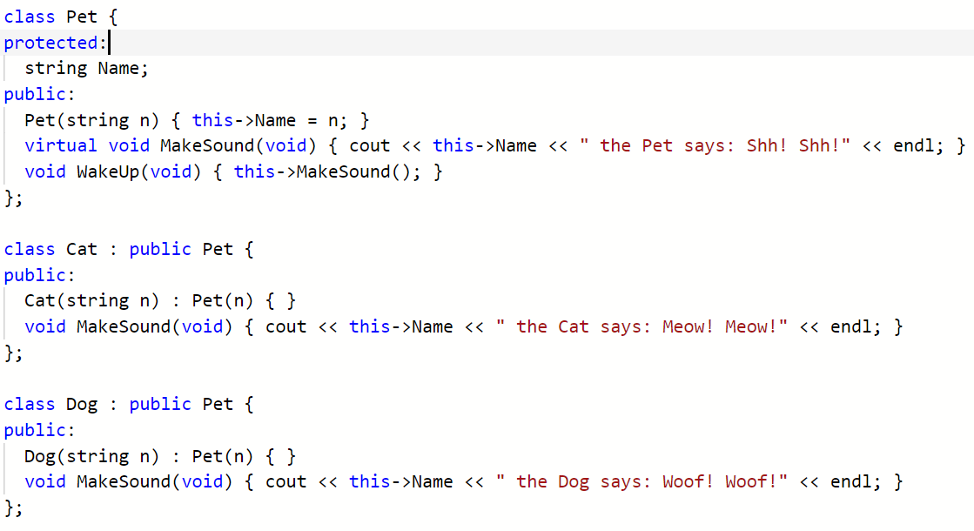

Slide 9
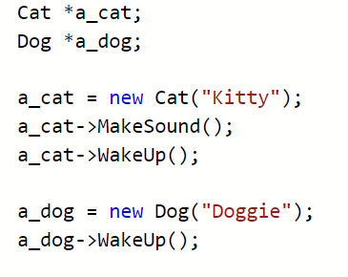


Slide 10
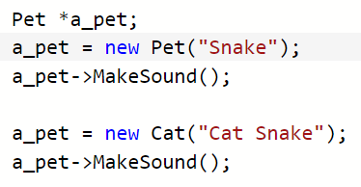


Slide 11
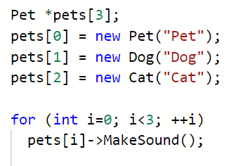


Slide 12
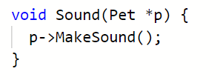



Slide 13
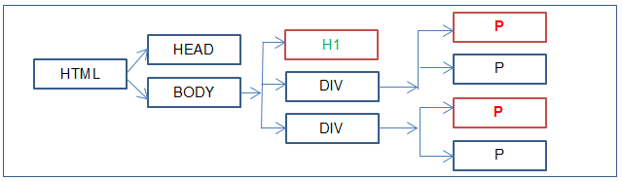
today
<html>
<head></head>
<body>
<h1>Title</h1>
<div>
<p>
Something
</p>
[… etc …]
</body>
</html>
Construct the following using OO and polymorphic techniques:
Shape
Square, circle, triangle, hexagon, pentagon
Area, perimeter, draw (render)
Cube, cylinder, other polyhedral
Surface area, volume
Or
HTML tags
Pretty print / render() method

Slide 14
Carter
Member initialization

Slide 15
May 27th bank holiday
Today – 6.3
Next week finish 6.4, 6.5, 6.6, 6.7 and take the quiz
Please actually do this!!

Slide 16
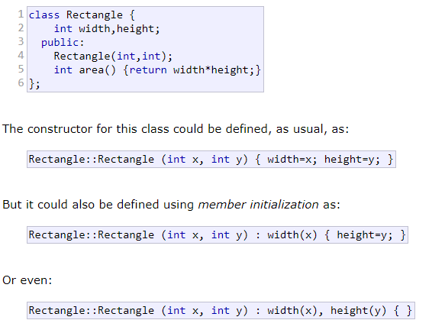
Member initialization in constructors
http://www.cplusplus.com/doc/tutorial/classes/

